Slide 1
Human trafficking, population, and GNI per capita
Leonardo Blas

Slide 2
What is human trafficking?
Coercing someone into labor, servitude, slavery, commercial sex, or organ removal.
Not smuggling, but smugglers may be or become traffickers.
Doesn’t necessarily involve transporting people.
Two stages: Recruitment and exploitation.

Slide 3
Questions with datasets in mind
Is a victim’s economic background connected to the way they were recruited?
Is a victim’s majority at entry connected to the country of exploitation’s population?

Slide 4
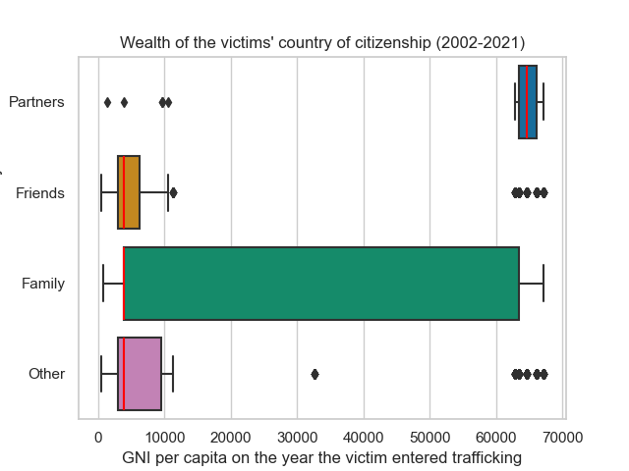
Recruitment types vs. victims’ economic background
Used the victim’s year of report and citizenship to query GNI per capita, a wealth metric.
Linked the wealth metric to the type of recruitment.
“Other” include traffickers, smugglers, contractors, etc.
There seems to be a connection between a victim’s economic background and their recruiters.

Slide 5
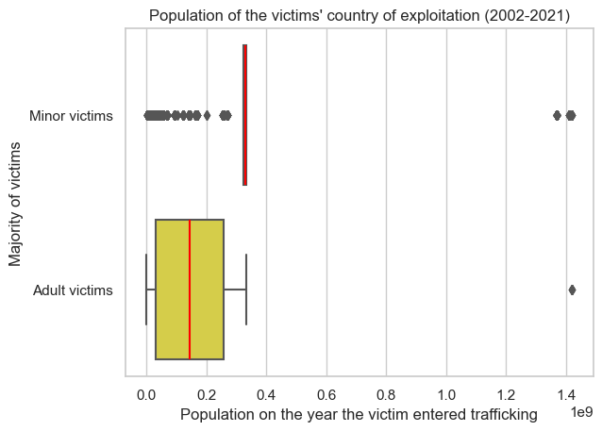
Victims’ majority at entry vs. population of the countries of exploitation
Victims are not necessarily exploited when entering trafficking.
Reportedly, most victims who enter trafficking as minors are exploited in the U.S. (only 1 case in the Philippines).
There seems to be a connection between adult human trafficking and countries with lower population.

Slide 6
Recommendations
Leverage computational social science to alleviate online components of human trafficking.
In a United Nations’ report of cases from 2004 to 2018:
~45% of cases involved online victim recruitment (texts, recruitment ads).
~57% of cases involved online ads for trafficking costumers.
Software could be used to disrupt recruitment ads or texts and identify trafficking ads, victims, or traffickers.

Slide 7
References
[1] Counter Trafficking Data Collaborative, "The Global K-anonymized Dataset". 2023. https://www.ctdatacollaborative.org/sites/g/files/tmzbdl2011/files/The%20Global%20K-anon%20Dataset%2015%20July%202021.xlsx.
[2] Counter Trafficking Data Collaborative, "Counter Trafficking Data Collaborative (CTDC) K-anonymized Data Codebook". 2021. https://www.ctdatacollaborative.org/sites/g/files/tmzbdl2011/files/CTDCk_codebook_v7_1.pdf.
[3] Counter Trafficking Data Collaborative, "The Global K-anonymized Data Dictionary". 2021. https://www.ctdatacollaborative.org/sites/g/files/tmzbdl2011/files/CTDC%20Global%20K-anon%20Dataset%20DATA%20DICTIONARY%20version%2020210825.xlsx.
[4] C. Fraser, "An analysis of the emerging role of social media in human trafficking: Examples from labour and human organ trading," International Journal of Development Issues, vol. 15, no. 2, pp. 98-112, 2016. Available: https://doi.org/10.1108/IJDI-12-2015-0076.
[5] UNODC, Global Report on Tracking in Persons 2020. 2020. https://www.unodc.org/documents/data-and-analysis/tip/2021/GLOTiP_2020_Chapter5.pdf.
[6] UNODC, Global Report on Tracking in Persons 2022. 2020. https://www.unodc.org/documents/data-and-analysis/glotip/2022/GLOTiP_2022_web.pdf.
[7] P. Campana, "Online and technology-facilitated trafficking in human beings", Council of Europe. 2022. https://rm.coe.int/online-and-technology-facilitated-trafficking-in-human-beings-summary-/1680a5e10c.

